Slide 1

Crime Pattern Detection, Analysis & Prediction

Slide 2
01 Introduction
02 Bliss of Automation
03 Use of Dataset
04 Data pre-processing
05 Vizualization
06 Time Series Forcasting
07 Classification
08 Clusttering
09 Crime mapping
10 Conclusion
CONTENTS

Slide 3
01 Why crimes should be predicted? (Introduction)
Crimes are a common social problem affecting the quality of life and the economic growth of a society.
Crimes could occur anywhere, it is common that criminals work on crime opportunities they face in most familiar areas for them. It is
considered as an essential factor that determines whether or not
people move to a new city and what places should be avoided when they travel .
By providing a data mining approach to determine the most criminal hotspots and find the type, location and time of committed crimes, we hope to raise people’s awareness regarding the dangerous
locations in certain time periods.
By hand, these are arduous tasks but AI categorization through massive amounts of visual data along with ML behavior
scripts AI/ML algorithms can eliminate human errors especially in
witness identification and therefore increasing arrest accuracy.

Slide 4
02
Bliss of Automation
Automation is the technology
by which a process or procedure
is performed with minimal human
assistance. By simplifying change through
automation, you gain the time and energy to
focus on innovation.
Steps:
Data Collection
Data Preparation
Choosing a Model
Train the Model
Evaluation of the Model
Parameter Tuning
Making Predictions
AI/ML are used to find locations or areas where most of the criminal activities takes place. AI/ML algorithms can eliminate human errors therefore increasing arrest accuracy.”Predictive policing” is the practice of identifying the date, times and
locations where specific crimes are most likely to occur, then scheduling officers to patrol those areas in hopes of preventing crimes from taking
place, therefore keeping neighbourhoods safer.

Slide 5
03 Use of Dataset
Preparation process
Data gathering
Classification / Clustering
Prediction / Forecast
The data which we have used in this model has been collected from
Toronto Police Service- Public safety portal.
This collected data can be used to extract meaningful information which
can help both the police department and the public to maintain safe
surroundings. Identifying crime and predicting dangerous hotspots at a
certain time and place could provide a better visualization for both public
and authorities.
In this dataset we have columns such as- Occurence date, month, reporting
date , Neighborhood, type of offence, MCI (or Major Crime Indicators). This
would help in clearly showcasing which neighbourhood are dangerous and
require more focus of police agencies. It would also supplement to the general public’s knowledge for their own well-being and safety.
We have used several time series forcasting along with classification and
clustering algorithms to validate the results.

Slide 6
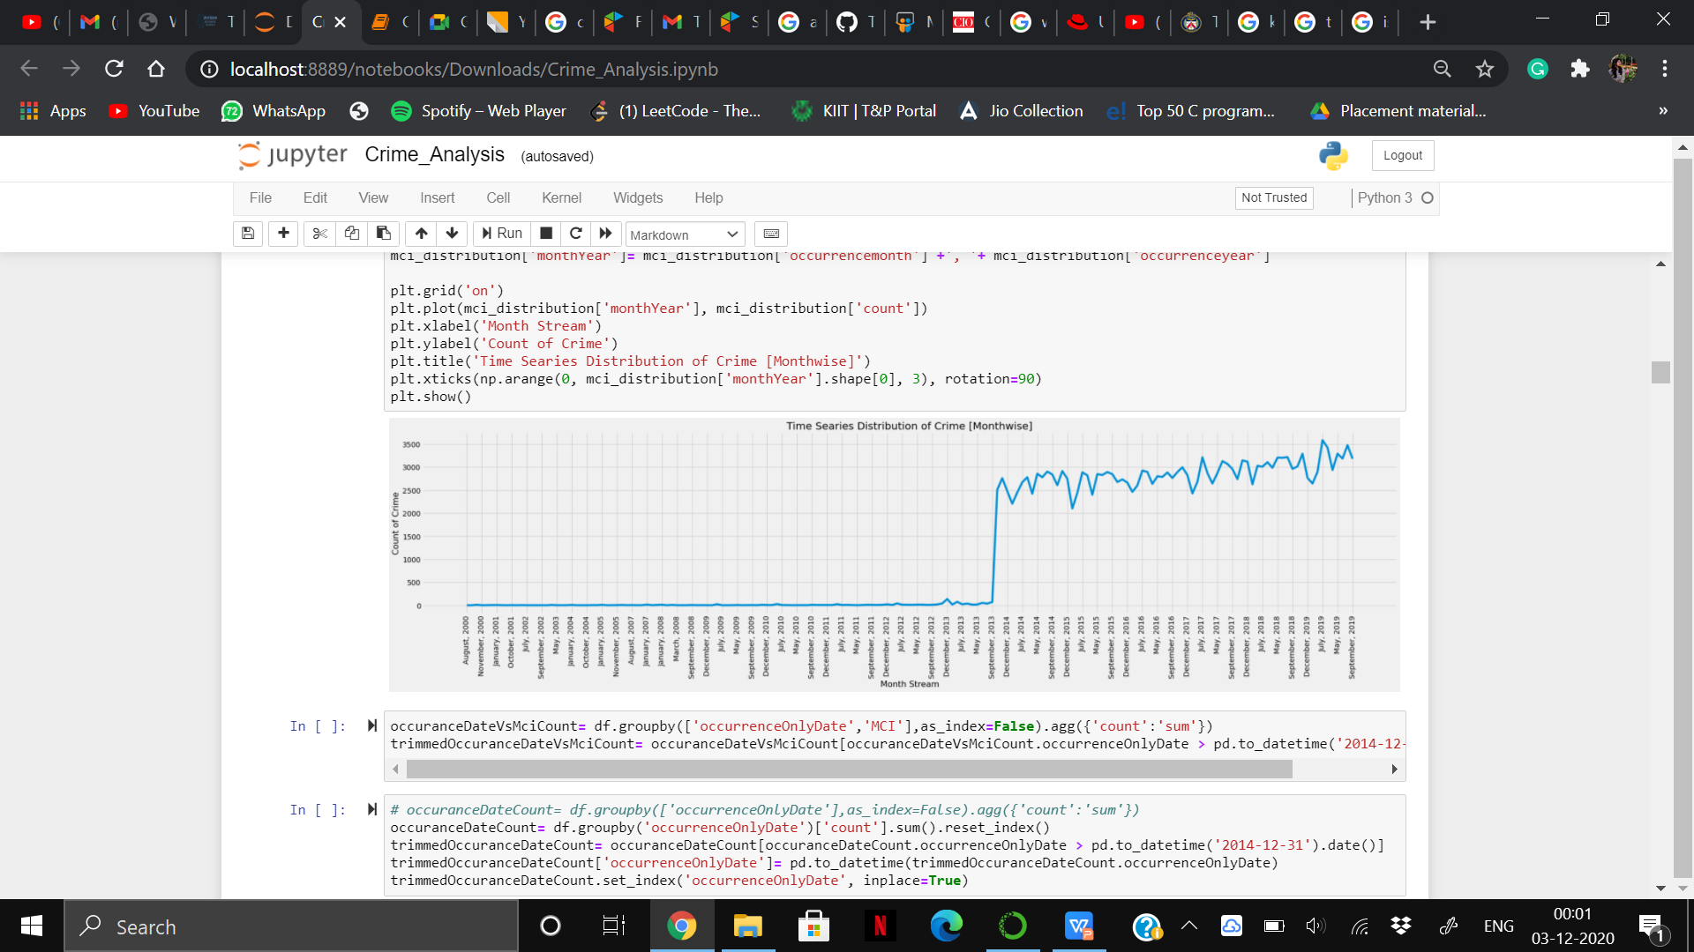
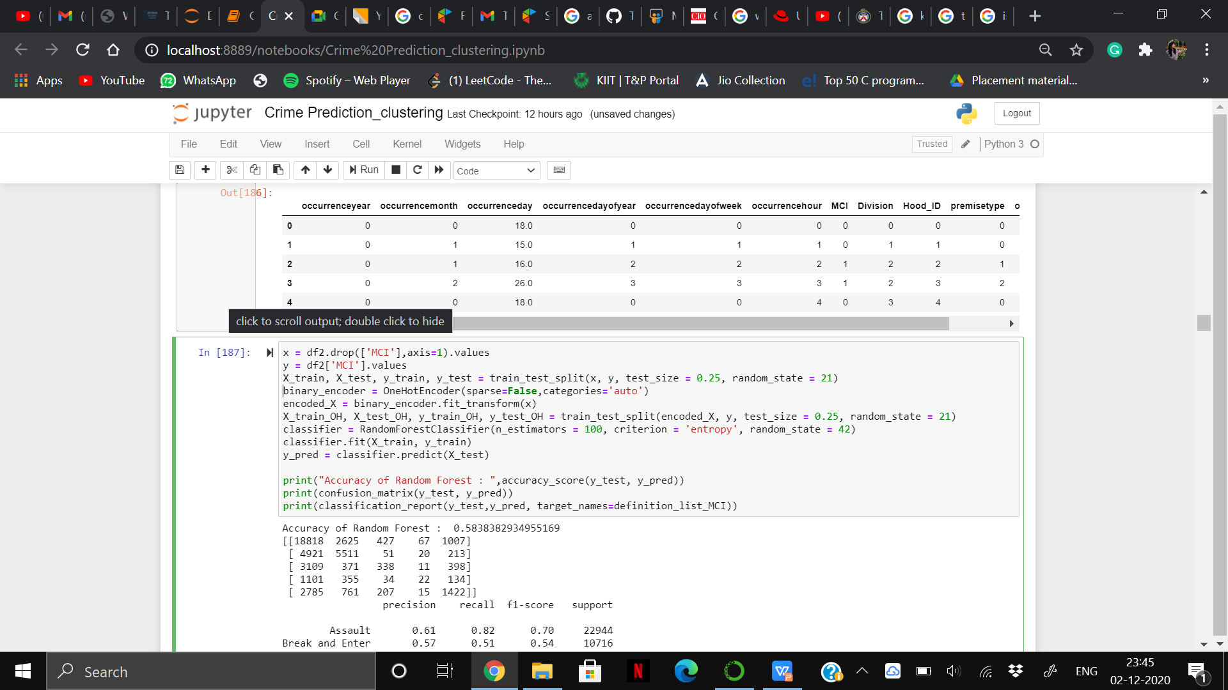
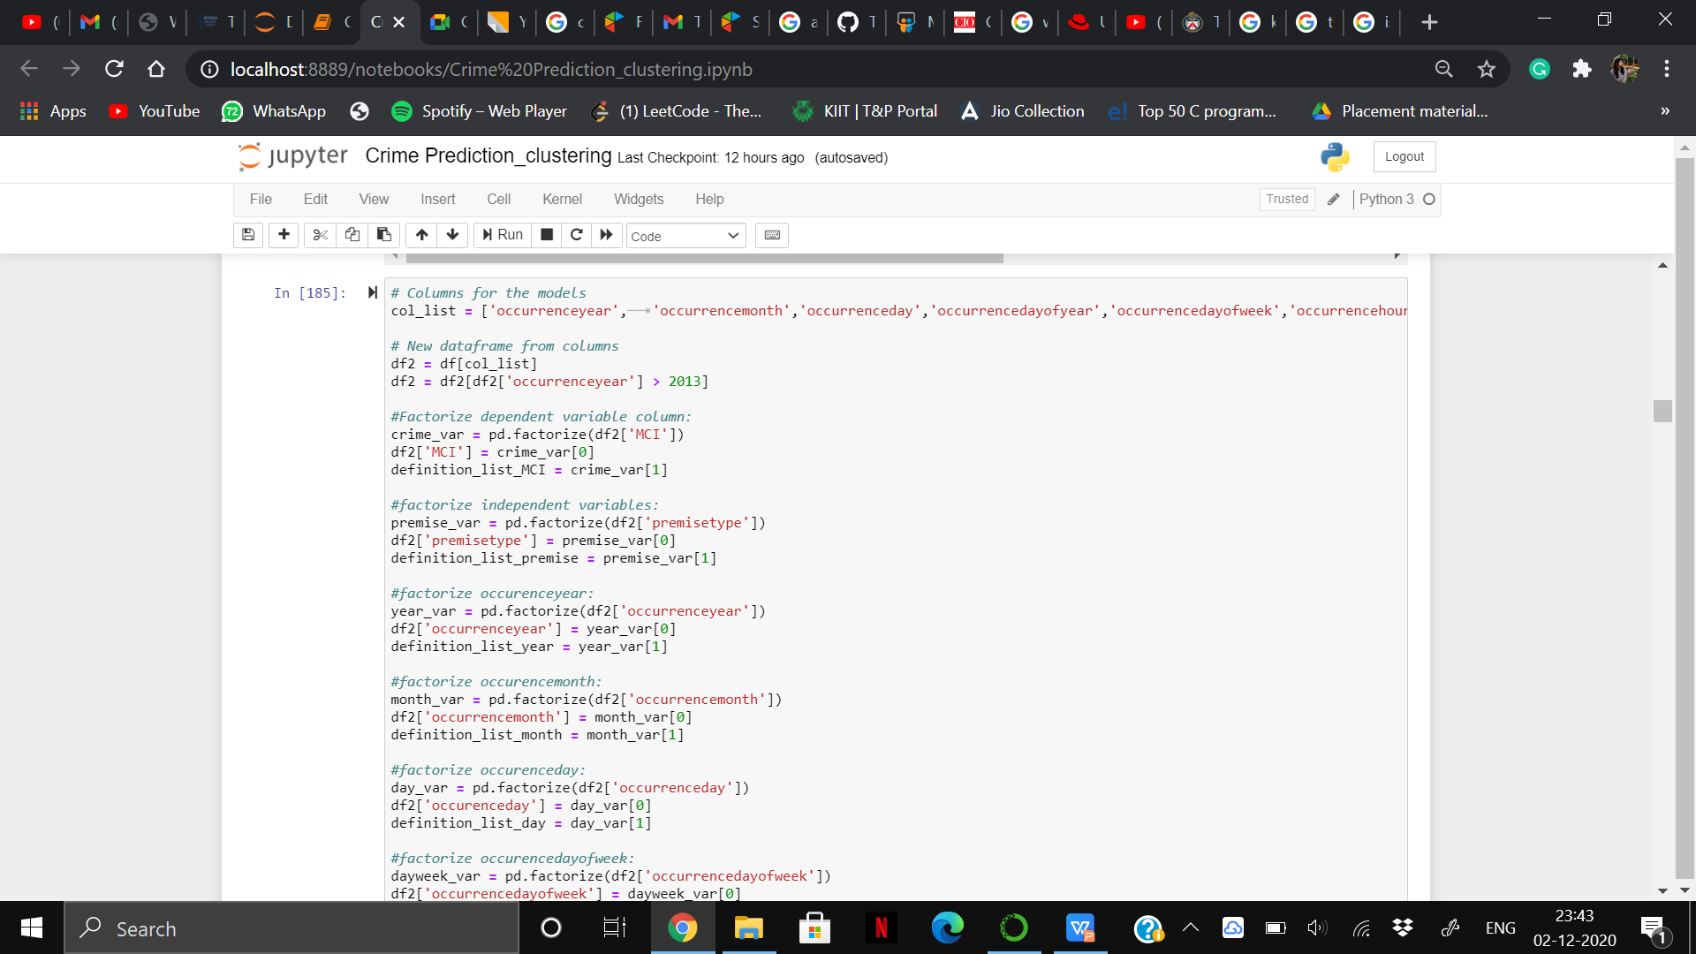
04 Data Pre-Processing
There were many duplicates as well as there werecolumns like X,Y coordinates , NeighborhoodID,
ReportDayOfweek, etc which were not that relevant
for predictions and clustering so we had to drop those
columns.
Using the data after dropping these columns we
have done various vizualizations using grouping
techniques.
We had to factorise various independent and
dependent variable for classification. Also,
OneHotEncoder() was used to all the X variables for
input into the classification model.
Also we, have considered those crimes which took
place after December 2014 as before that there were not sufficient data.

Slide 7
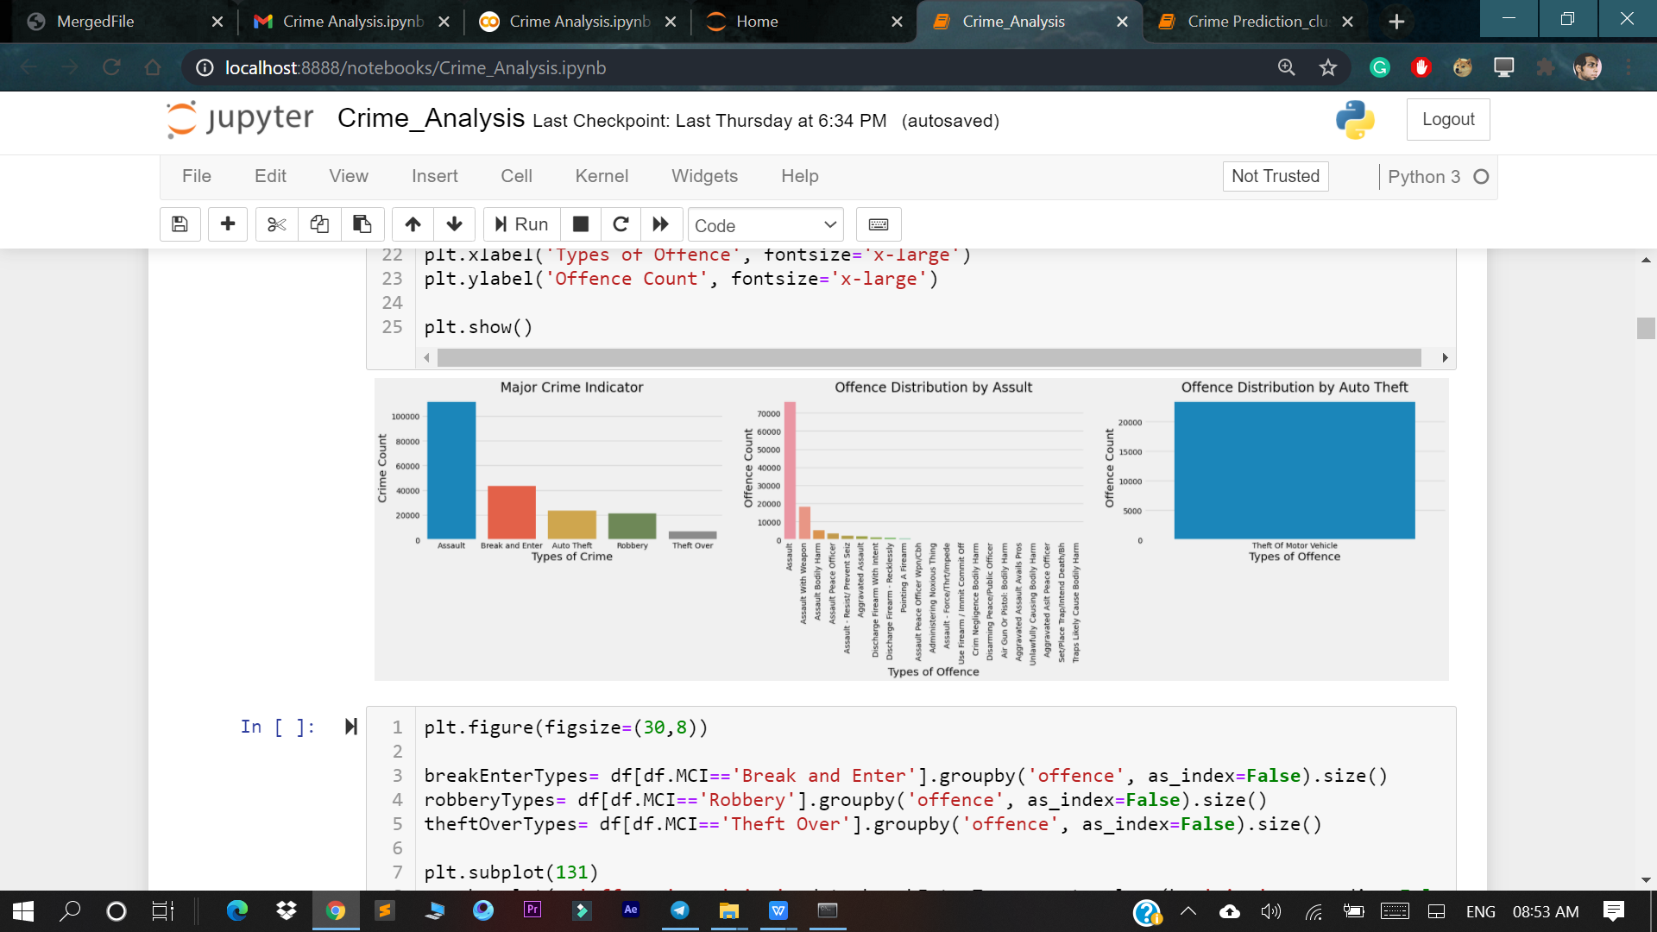
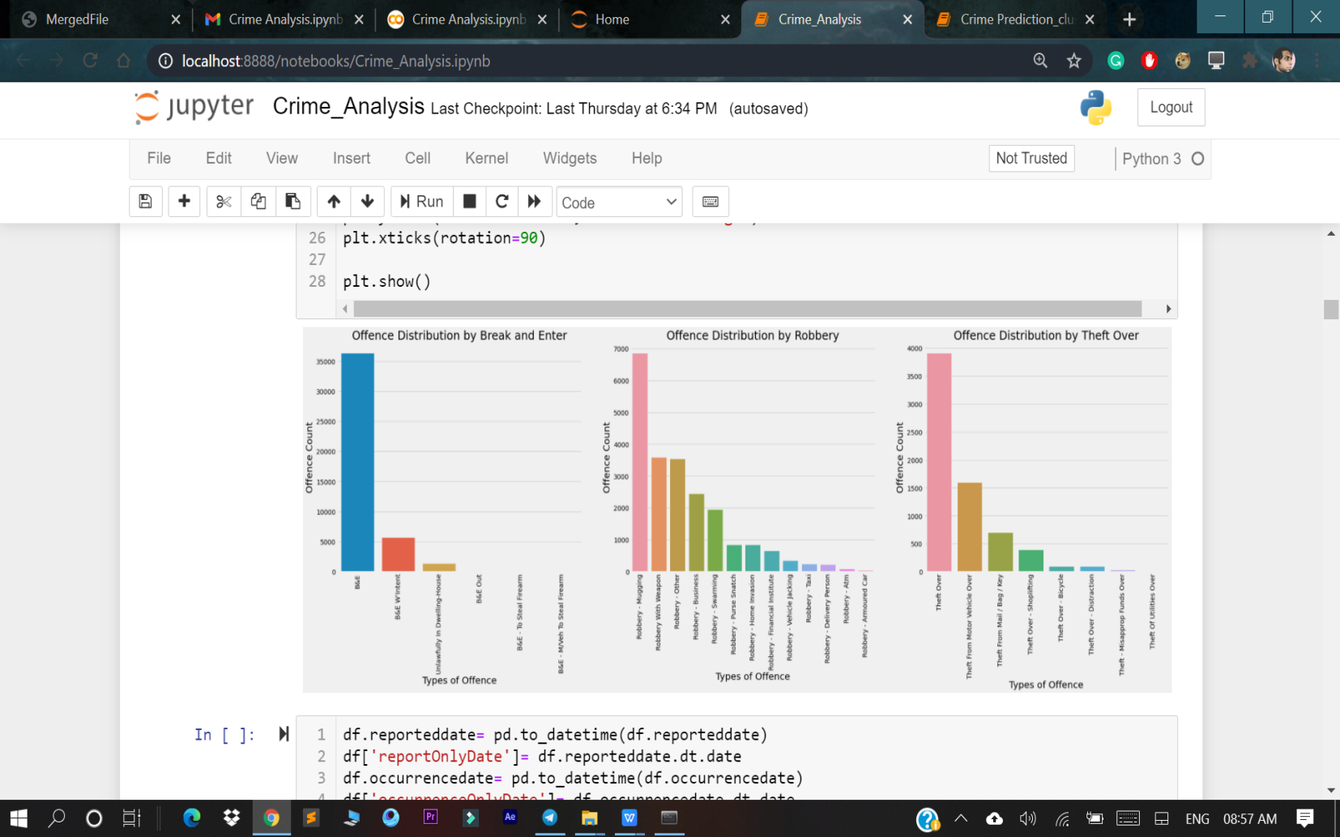
05
Vizualization

Slide 8
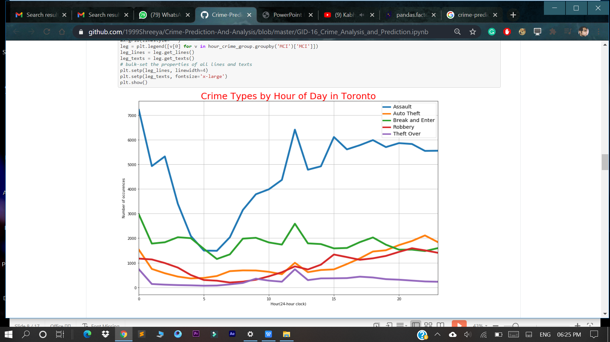
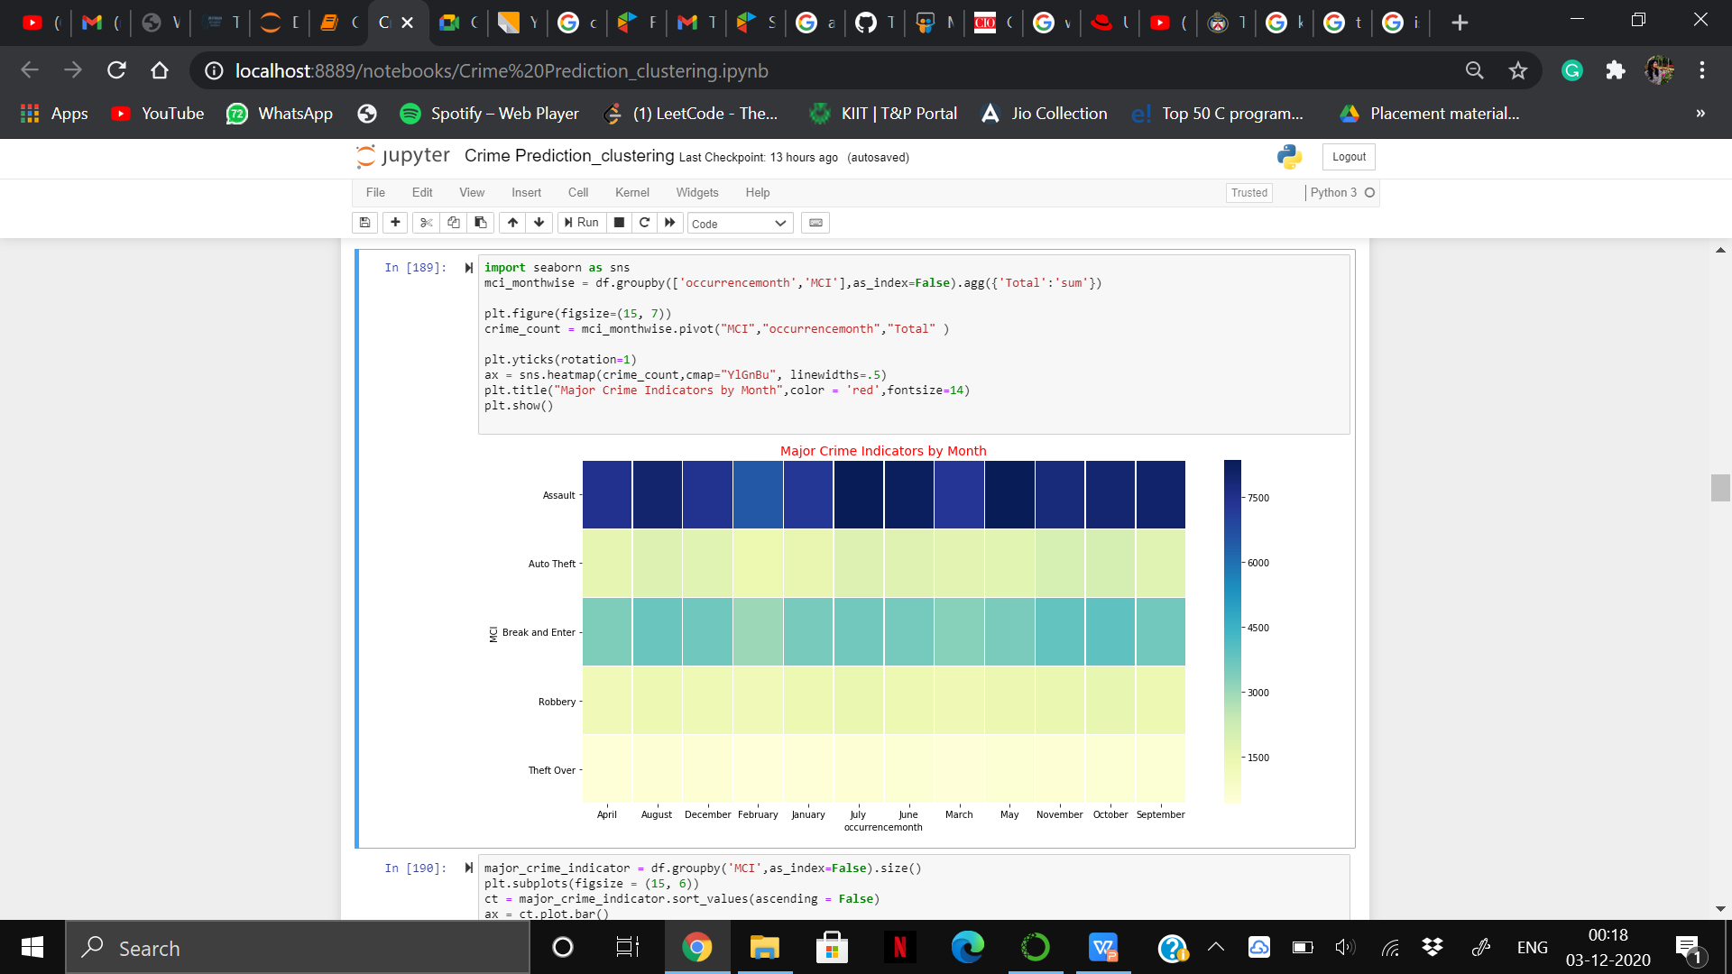
05
Vizualization

Slide 9
06
Time Series Forcasting
ARIMA Time Series Forcasting: A popular and widely used statistical method for time
series forecasting is the ARIMA model. ARIMA is an acronym that stands for
AutoRegressive Integrated Moving Average. It is a class of model that captures a suite
of different standard temporal structures in time series data.
AR: Autoregression. A model that uses the dependent relationship between an observation and some number of lagged observations.
I: Integrated. The use of differencing of raw observations (e.g. subtracting an observation from an observation at the previous time step) in order to make the time series stationary.
MA: Moving Average. A model that uses the dependency between an observation and a residual error from a moving average model applied to lagged observations.
SARIMA for Time Series Forecasting: An extension to ARIMA that supports the direct
modeling of the seasonal component of the series is called SARIMA.

Slide 10
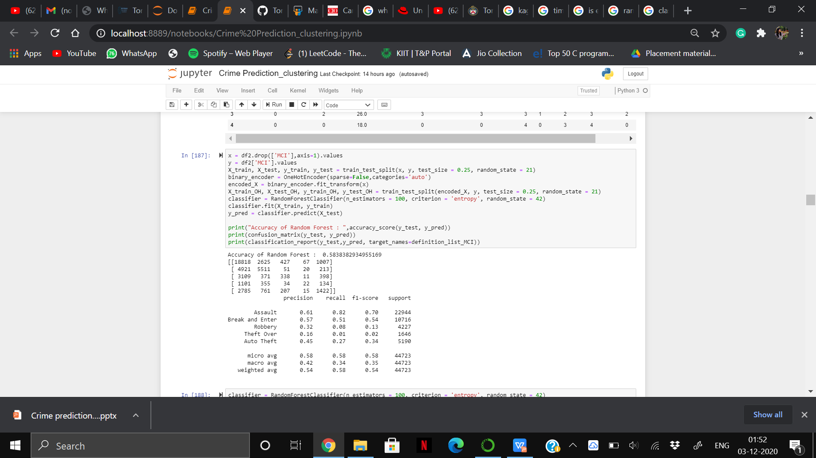
07 Classification
Classification refers to a predictive modeling
problem where a class label is predicted for a given example of input data.
In this project, we have used Rnadom Forest
Classification algorithm which operate by
constructing a multitude of decision trees at training
time and outputting the class that is the mode of the
classes or mean/average prediction of the individual
trees and have got an accuracy of 58.38%.

Slide 11
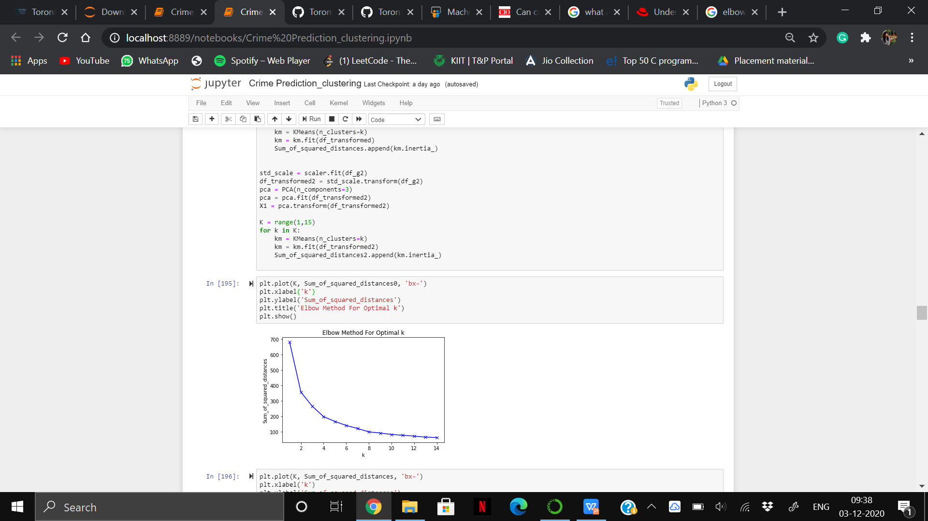
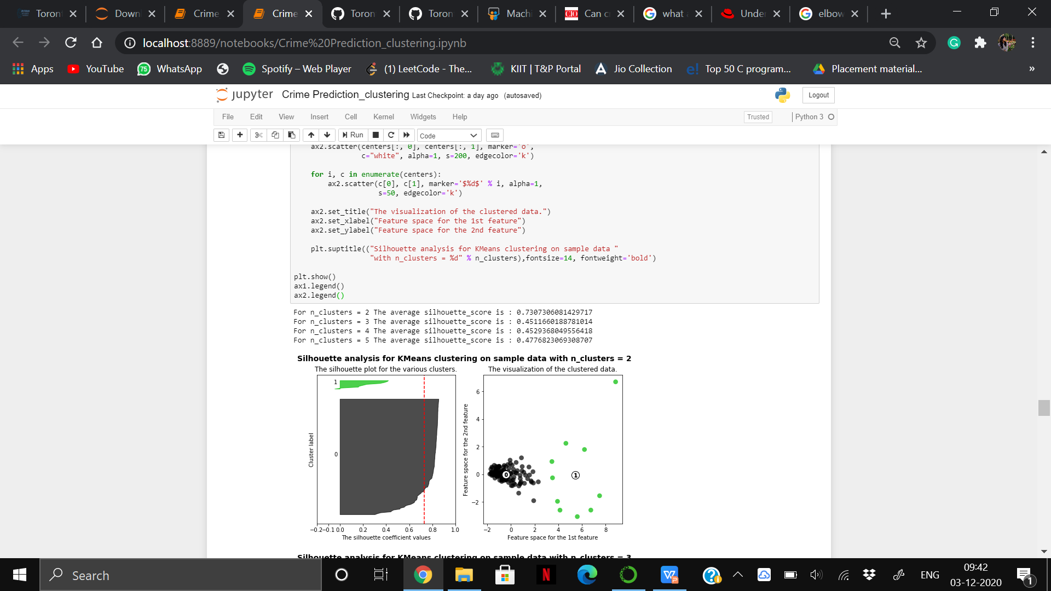
08 Clustering
Clustering, is an unsupervised machine learning task. It involves
automatically discovering natural grouping in data.
In this model we have used K-Means Clustering technique that aims to partition n observations into k clusters in which each
observation belongs to the cluster with the nearest mean (cluster centers or cluster centroid), serving as a prototype of the cluster.
We have chosen Elbow method to determine number of
clusters in the dataset.
Also we have done visualization of clustered data and silhouette plot for various clusters and displayed Crime neighbourhoods
by K-Means.

Slide 12
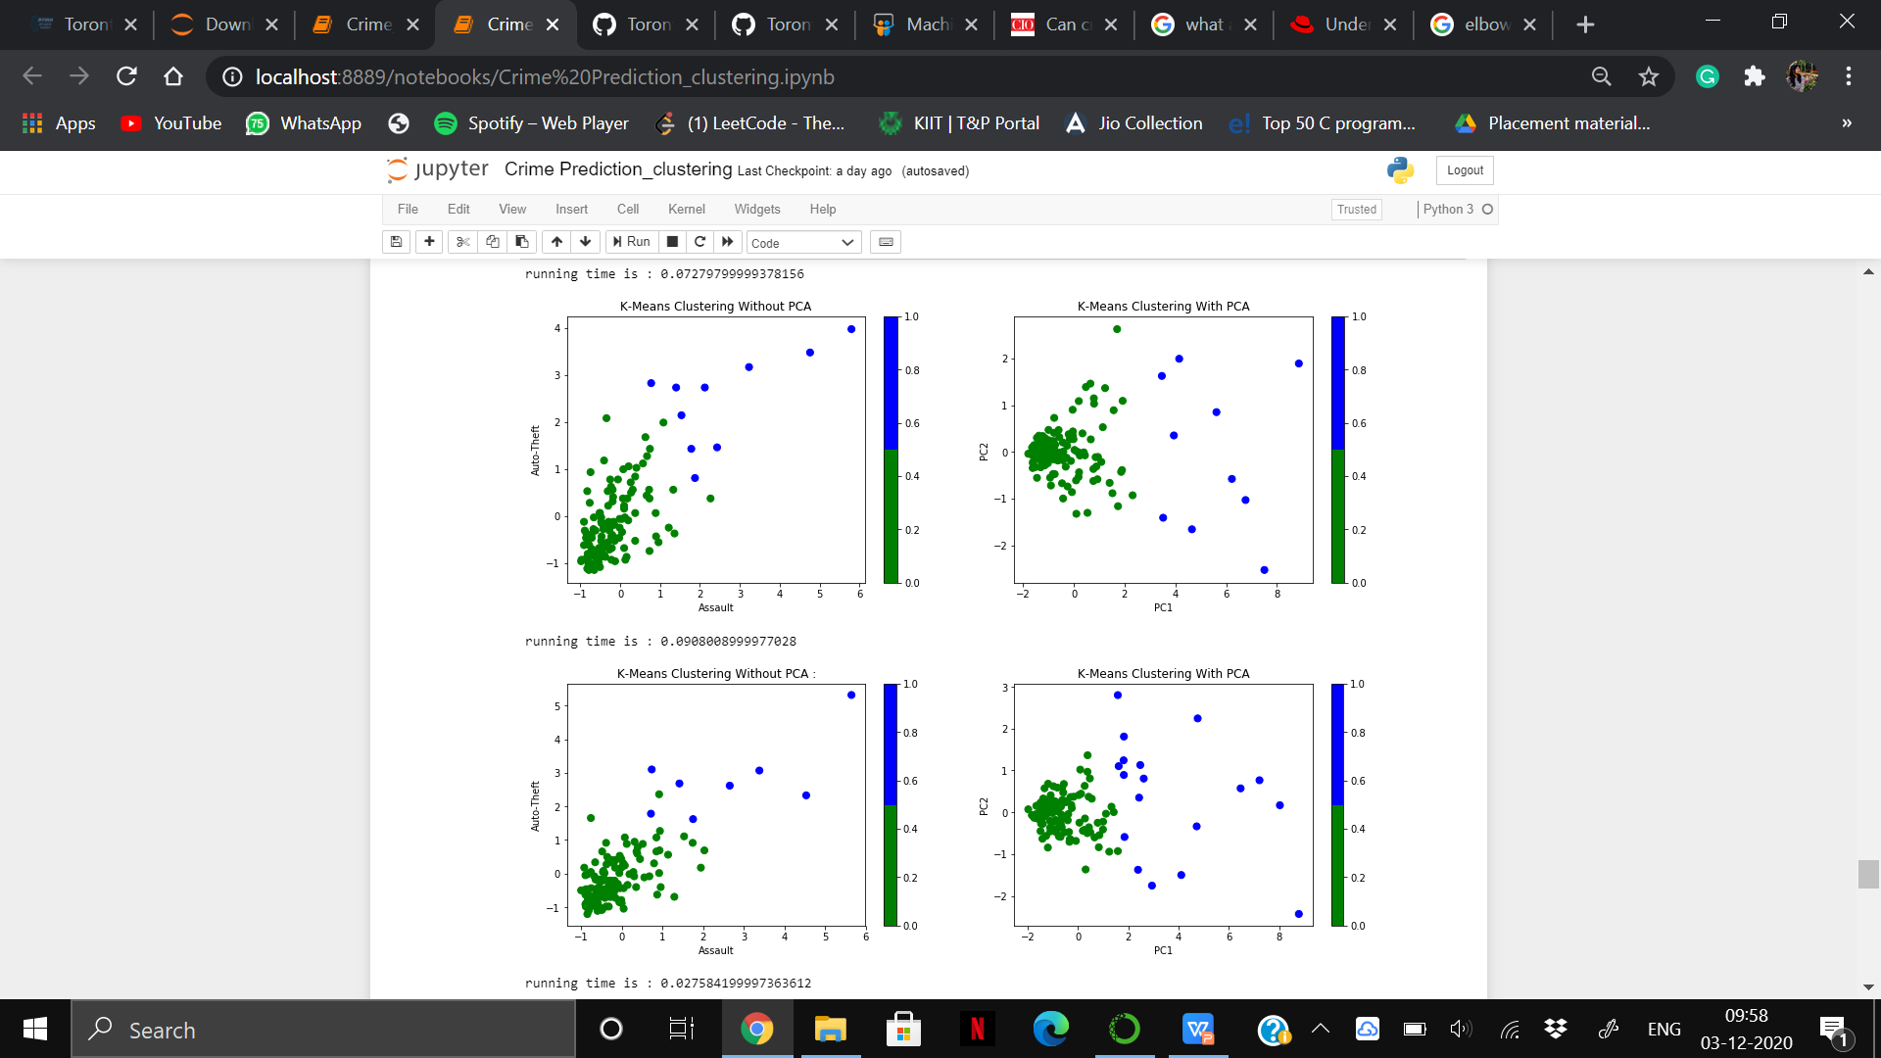
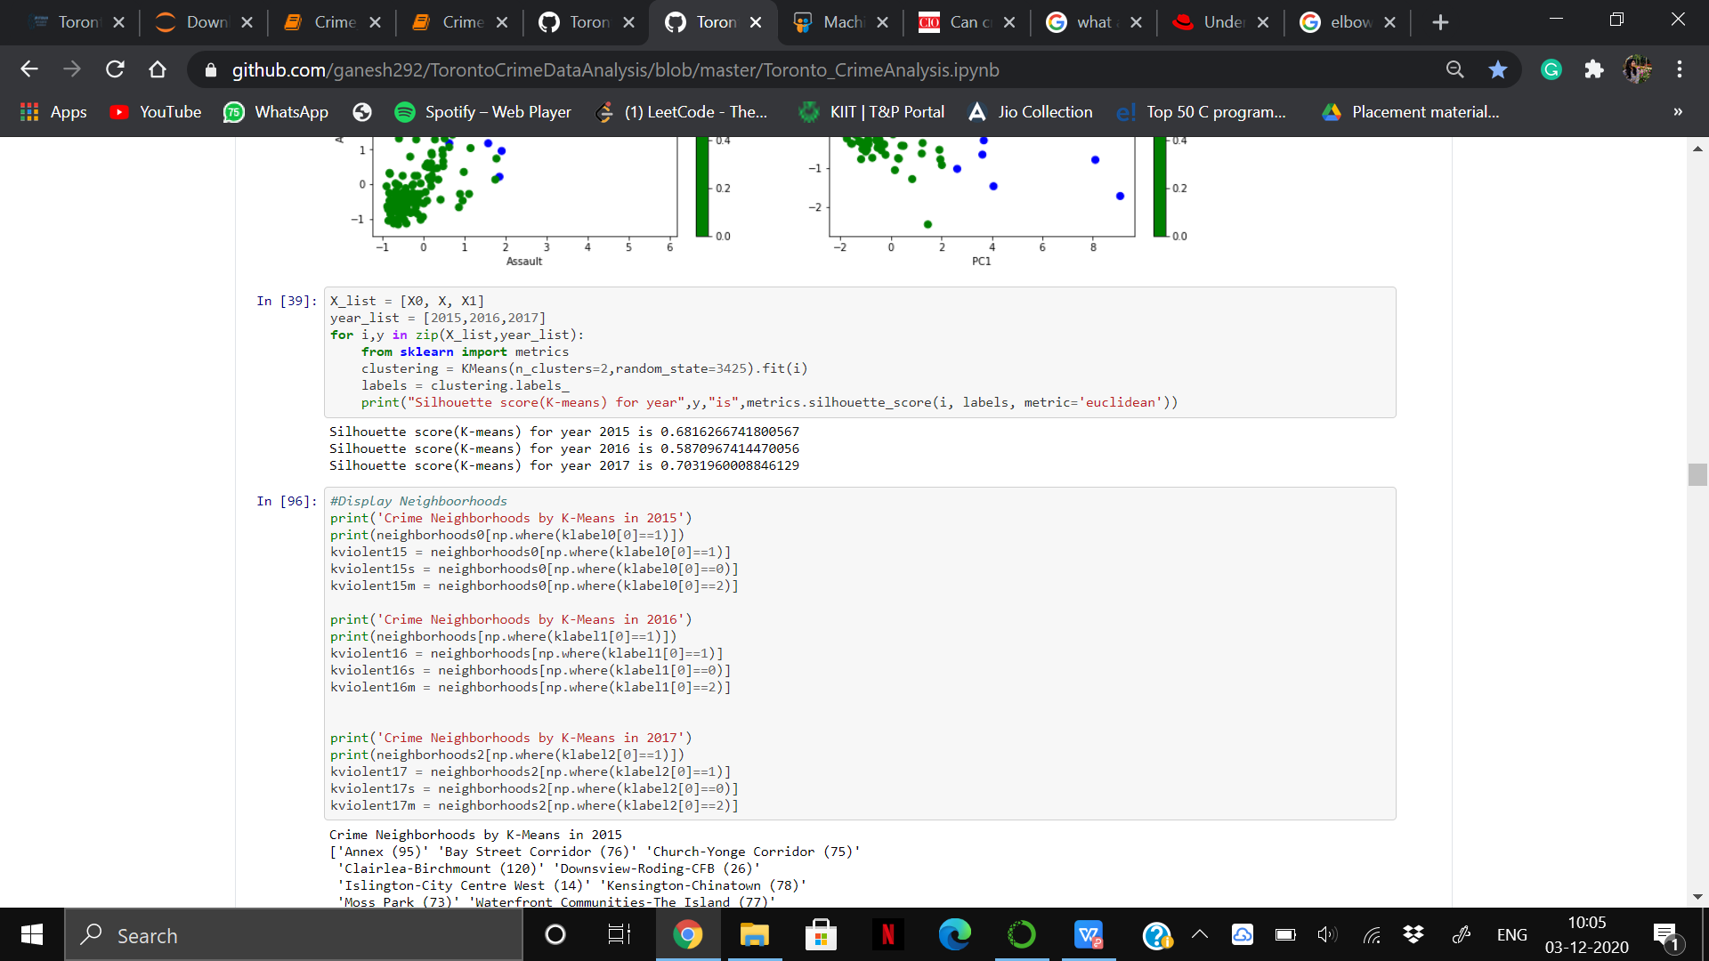
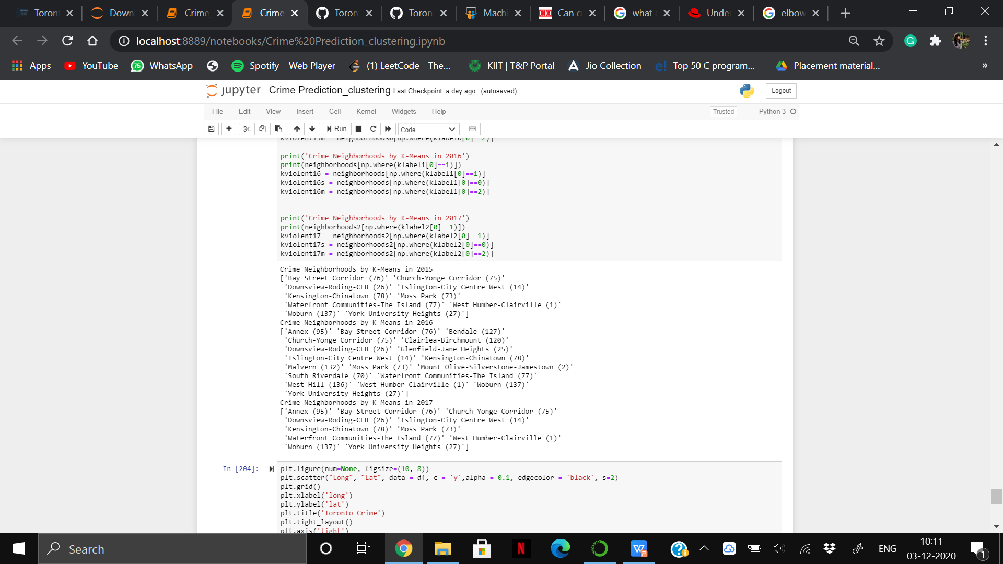
Silhouette score of different clusters
We have done the clustering twice one with PCA and one without PCA. Using PCA we have got good clusters and also running time
was quite less.
Neighbourhoods where crime occurred the
most in consecutive three years

Slide 13
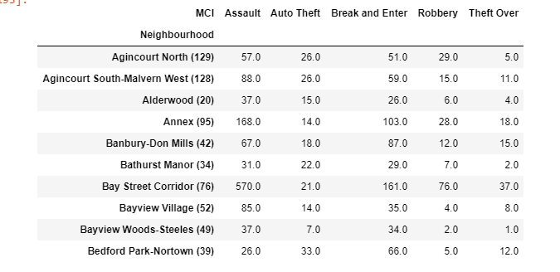
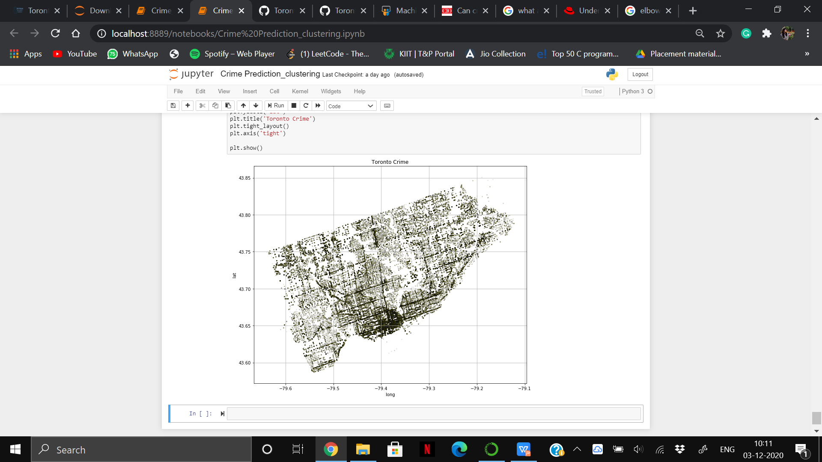
09
CRIME MAPPING
Places of high-density of crime
Result after grouping Neighbourhood
with MCI

Slide 14
Conclusion and Future Work
The spatial analysis of crime in the city of Toronto demonstrates interesting relationships between police-reported
crime and neighbourhoods associated with them. Outcomes of this analysis have shown how certain neighbourhood characteristics are related to a higher degree of crime rates.
This study will aid in identifying crime and predicting dangerous hotspots at a certain time and place and also in
proper planning and safety measures to stop the antisocial activities from happening in the community.
In the future, we can find people or groups who have committed the crime and find reasons behind these activities.
Also, we would like to predict future crime spots which will include more number of places/ cities. Thus providing a broader aspect of criminal activities.
While there is little reason to believe that the crime rate will increase dramatically in the first decade of the 21st Century, given the anticipated increases in the globalization, sophistication and organization of crime, one may conclude that the impact of crime on Western societies may be more severe than the one witnessed under a similar rate of crime in the past. The goal of any society shouldn’t be to just catch criminals but to prevent crimes from happening in the first place.

Slide 15
THANK YOU

